Slide 1

The Marketing Mix

Slide 2
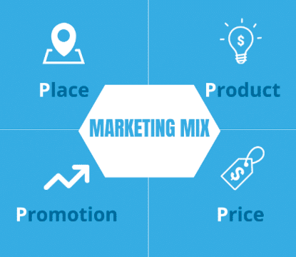
Learning Objective
What is Marketing
What is Included in Marketing
What is the Marketing Mix
What is the 4ps of Marketing

Slide 3
Review What is Marketing

Slide 4
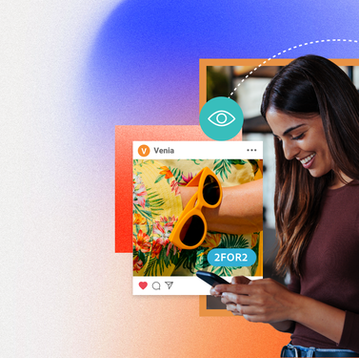
Definition of Marketing
Marketing: the process of creating, promoting (communicating), selling, and delivering goods or services to customers through products that customers WANT and NEED
Notice the Underlined words
Said another way: It's about understanding customer needs, designing products that meet those needs, and making sure customers know about them and where to purchase them

Slide 5
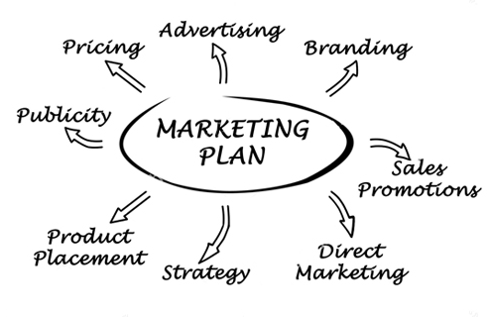
Marketing Includes Just to name a few key aspects:
Naming/Branding your business
Advertising/Promoting your products
Sales Promotions
Building websites, social media etc.
Pricing your products
Publicity
Product Placement

Slide 6

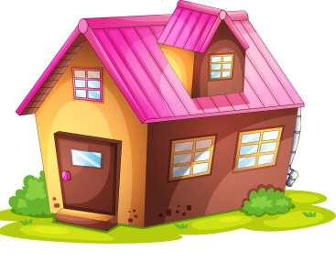
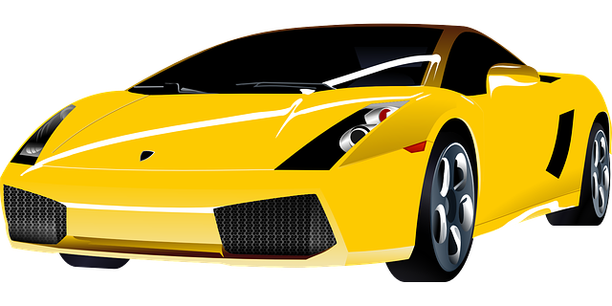


Want vs Need
Need: A need is a basic unit of survival. It is something that a person cannot live without
Want: A want is something that we would like to have, but we can live without it
In Business, which do you think businesses are Marketing most often, a want or a need?

Slide 7
Two Approaches of Marketing
Traditional Methods of Marketing
Digital Marketing

Slide 8
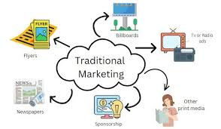
Traditional Marketing
Traditional marketing is a promotional strategy that uses offline media to reach an audience.
Examples of traditional marketing include:
Print ads: Newspaper, magazine, and other print ads
Billboards: Outdoor advertising
Direct mail: fliers, postcards, and posters sent directly to consumers in the mailbox
TV and radio commercials: Broadcast advertising
Coupons: Informational packets
Telephone calls: Phone marketing

Slide 9
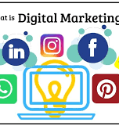
Digital Marketing
Digital Marketing: promotional activities that use online or digital channels to promote a brand and connect with potential customers.
Examples of Digital Marketing includes
Websites
Social media
Email
Mobile apps
SMS Text Messages - and text notifications:
Social Media Marketing

Slide 10

Assignment
Go to Google Classroom and Complete the ED-puzzle, what is marketing
Quick Write Activity: In your packet, if you owned a business, do you believe you would use Traditional marketing, Digital Marketing, or both methods?

